Slide 1
Industial Tools for Formal Specification
Presentation

Slide 2
Contents of this template
Hooria | Introduction, Algebric Tools
Qaswar Sarfaraz | Model Based Tools
Sheeraz Ali | Theorem Provers
Sadia | Syntax Checker, Conclusion
Teacher: Dr. Nargis Fatima

Slide 3
Table of contents
1.
Introduction
4.
Theorem Provers
2.
Algebraic Tools
5.
Syntax Checkers
3.
Model-Based Tools
6.
Conclusion

Slide 4
01
Introduction

Slide 5
Introduction
What is Formal Specification?
Why is it important?
Helps detect inconsistencies, incompleteness, and ambiguities early.
Facilitates rigorous analysis and validation.
A mathematical approach to describing software system requirements and behavior.
Ensures unambiguous, precise, and verifiable documentation.

Slide 6
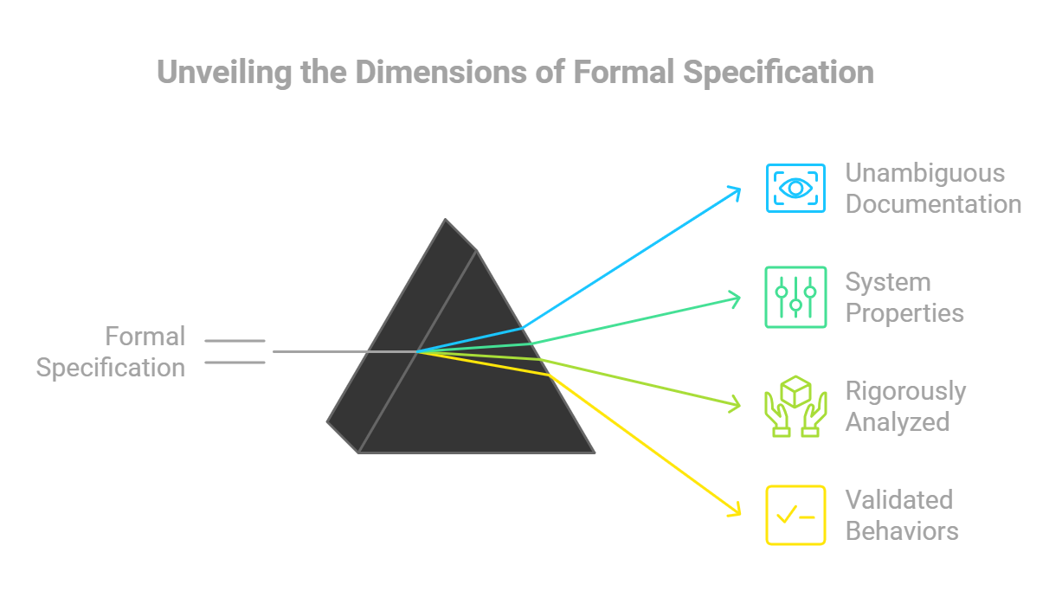

Slide 7
02
Algebric Tools

Slide 8
Algebraic Tools
Example: Larch
Definition
Algebraic tools use abstract data types and operations to formally specify software systems.
Focus on defining the system’s functions and their relationships rather than how they are implemented.
Ideal for modular systems, ensuring correctness in operation behavior.
Scenario: An online shopping cart.
Larch specifies operations like addItem(product, quantity) and removeItem(product) in terms of behavior.
Rule Example: addItem increases the total count of products, while removeItem reduces the count but fails if the item is not in the cart.
Specification:
Preconditions: item exists.
Postconditions: item count increases or error message shown.

Slide 9
Algebraic Tools
Importance
Precision: Defines rules for operations unambiguously.
Modularity: Enables independent development and analysis of different system components.
Error Detection: Ensures the consistency and correctness of operations early in design.
Reusable Components: Specifications can be reused across different projects or systems.

Slide 10
03
Model-Based Tools

Slide 11
Model-Based Tools - Z Notation
Introduction
Model-based tools use mathematical models to represent system behavior, focusing on states and transitions.
They describe how a system evolves over time and how different components interact.
Commonly used for state-driven systems like banking, transportation, and telecommunications.
Example: Z Notation
Scenario: Library management system.
Z specifies rules for actions like BorrowBook(user, book) and ReturnBook(book).
Rule Example:
Preconditions: The book is available, and the user has not exceeded their borrowing limit.
Postconditions: The book is marked as borrowed, and the borrowing count for the user is updated.

Slide 12
Model-Based Tools - Z Notation
Importance
Visual Clarity: Models provide a clear and structured representation of system behavior.
Error Prevention: Helps identify edge cases and inconsistencies early.
Versatility: Suitable for a wide range of domains, including safety-critical systems.
Formal Verification: Mathematical rigor ensures correctness in system design.

Slide 13
04
Theorem Provers

Slide 14
Theorem Provers
Introduction
Example
Theorem provers verify the logical correctness of system requirements by using mathematical proofs.
They automate or assist in proving the system satisfies the specified requirements.
Commonly used for safety-critical systems where errors are unacceptable.
Coq:
Scenario: Flight control system.
Coq proves that the autopilot system never allows the plane to descend below a safe altitude.
Proof Example: Use logic to validate that all possible inputs (e.g., altitude, speed) keep the system in a safe state.

Slide 15
Theorem Provers
Importance
High Reliability: Ensures systems behave exactly as specified.
Formal Guarantees: Provides mathematical assurance for safety-critical domains like aviation or healthcare.
Bug Detection: Finds logical errors early in design.
Automation: Reduces manual effort in verifying complex requirements.

Slide 16
05
Syntax Checkers

Slide 17
Syntax Checkers
Introduction
Example
Syntax checkers ensure formal specifications follow the correct structure and rules of the chosen language.
They act as the first step in formal verification by detecting errors in specification syntax.
SPIN:
Scenario: Chat application.
SPIN checks if the protocol’s syntax (e.g., sending and receiving messages) is valid.
Rule Example: Ensures messages are sent before being received, avoiding communication deadlocks.

Slide 18
Syntax Checkers
Importance
Early Error Detection: Finds syntax and structural issues before deeper analysis.
Saves Time: Reduces debugging effort by catching simple mistakes early.
Consistency: Ensures specifications align with formal language rules.
Support for Formal Methods: Serves as a foundational tool for advanced verification processes.

Slide 19
06
Conclusions

Slide 20
CONCLUSION,
Formal specification tools are essential for creating reliable and error-free software. Each type of tool has its own role: algebraic tools define operations clearly, making systems modular and reusable; model-based tools use diagrams and states to show how systems behave; theorem provers ensure critical systems work correctly by using mathematical proofs; and syntax checkers catch errors in the early stages of design. Together, these tools help developers find and fix problems early, save time and costs, and build stronger, more dependable systems. Despite some challenges like learning complexity, their benefits make them valuable for modern software development.

